Slide 1
Lending Club Case study
Understanding of risk analytics in banking and financial services and understand how data is used to minimize the risk of losing money while lending to customers.

Slide 2
Lending loans to risky applicants is the largest source of financial loss which is called the credit loss, Credit loss is the amount of money lost by the lender when borrower refuses to pay or runs away with the money owed. The main objective is to be able to identify these risky applicants, then such loans can be reduced thereby cutting down the amount of credit loss. Identification of such applicants using EDA is the main aim of this case study.

Slide 3
Approach: -> Data cleaning. -> Univariate analysis. -> Segmented univariate analysis. -> Bivariate/Multivariate analysis.

Slide 4
Univariate Analysis
The number of defaulted loan is 7 times less than the number of fully paid loan.
The majority of loan has a term of 36 months compared to 60 months.
The interest rate is more crowded around 5-10 and 10-15 with a drop near 10.
A large amount of loans are with grade 'A' and 'B' compared to rest showing most loans are high grade loans.
Majority of borrowers have working experience greater than 10 years.
Majority of borrowers don't posses property and are on mortgage or rent.
Annual Income shows left skewed normal distribution thus we can say that the majority of burrowers have very low annual income compared to rest.

Slide 5
A large percentage of loans are taken for debt consolidation followed by credit card.
Majority of the borrowers are from the large urban cities like California, new York, Texas, Florida etc.
Majority of the borrowers have very large debt compared to the income registered, concentrated in the 10-15 DTI ratio.
Majority of the borrowers have no record of Public Recorded Bankruptcy.
Majority of the loans are given in last quarter of the year. The number of loans approved increases with the time at exponential rate, thus we can say that the loan approval rate is increasing with the time.
About 50% of the borrowers are verified by the company or have source verified.

Slide 6
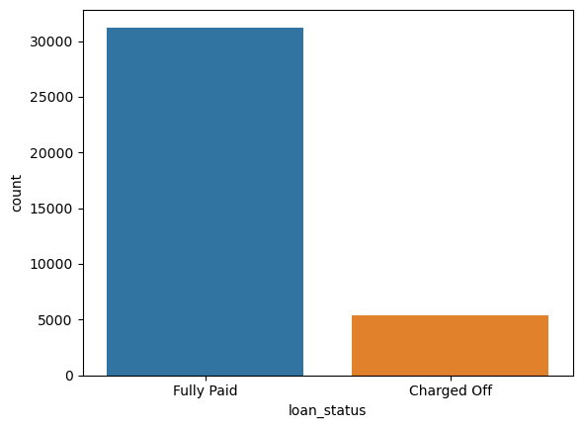
Example for a univariate
Analysis, plot for loan status

Slide 7
Segmented Univariate Analysis
Debt Consolidation is the most popular loan purpose and has highest number of fully paid loan and defaulted loan.
The mean and 25% are same for both but we see larger 75% in the defaulted loan which indicate large amount of loan has higher chance of defaulting.
The 60 month term has higher chance of defaulting than 36 month term whereas the 36 month term has higher chance of fully paid loan.
The loans in 36 month term majorly consist of grade A and B loans whereas the loans in 60 month term mostly consist of grade B, C and D loans.
The Loan Status varies with DTI ratio, we can see that the loans in DTI ratio 10-15 have higher number of defaulted loan but higher dti has higher chance of defaulting.

Slide 8
Borrowers with less 50000 annual income are more likely to default and higher annual income are less likely to default.
The Fully paid loan are increasing exponentially with the time compared to defaulted loan.
The default loan amount increases with interest rate and shows are decline after 17.5 % interest rate.
The Employees with 10+ years of experience are likely to default and have higher chance of fully paying the loan.
The Defaulted loan are lower for the burrowers which own their property compared to on mortgage or rent.

Slide 9
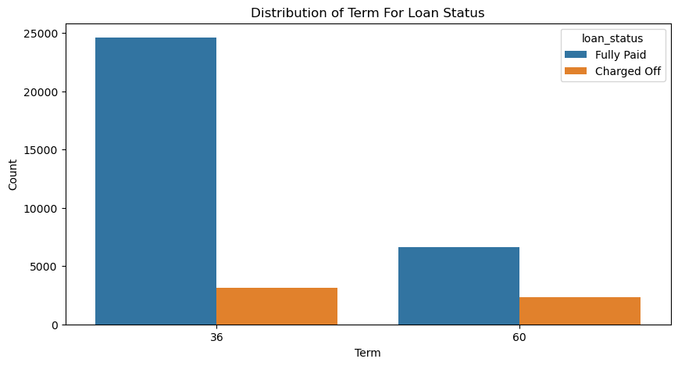
Distribution of
Term based on
loan_status

Slide 10
Bivariate Analysis
The Grade represent risk factor thus we can say interest rate increases with the risk.
The Grade A which is lowest risk also has lowest DTI ratio which we can say that higher grade has lower rate of default.
The borrowers are mostly having no record of Public Recorded Bankruptcy and are safe choice for loan issue.

Slide 11
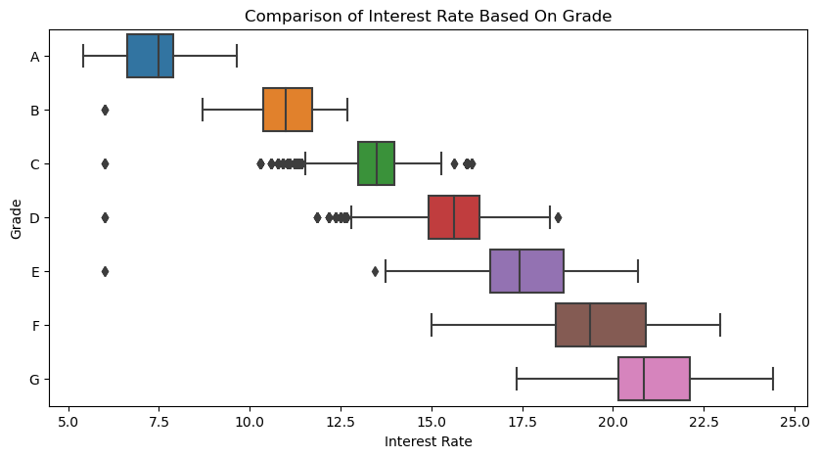
Box plot for a bivariate analysis - Comparison of interest rate based on grade

Slide 12
Conclusion
Major Driving factor which can be used to predict the chance of defaulting and avoiding Credit Loss:
DTI
Grades
Verification Status
Annual income
Pub_rec_bankruptcies

Slide 13
Other considerations for 'defaults' :
Burrowers not from large urban cities like California, new York, Texas, Florida etc.
Burrowers having annual income in the range 50000-100000.
Burrowers having Public Recorded Bankruptcy.
Burrowers with least grades like E,F,G which indicates high risk.
Burrowers with very high Debt to Income value.
Burrowers with working experience 10+ years.

Slide 14
Thank you!

